Slide 1
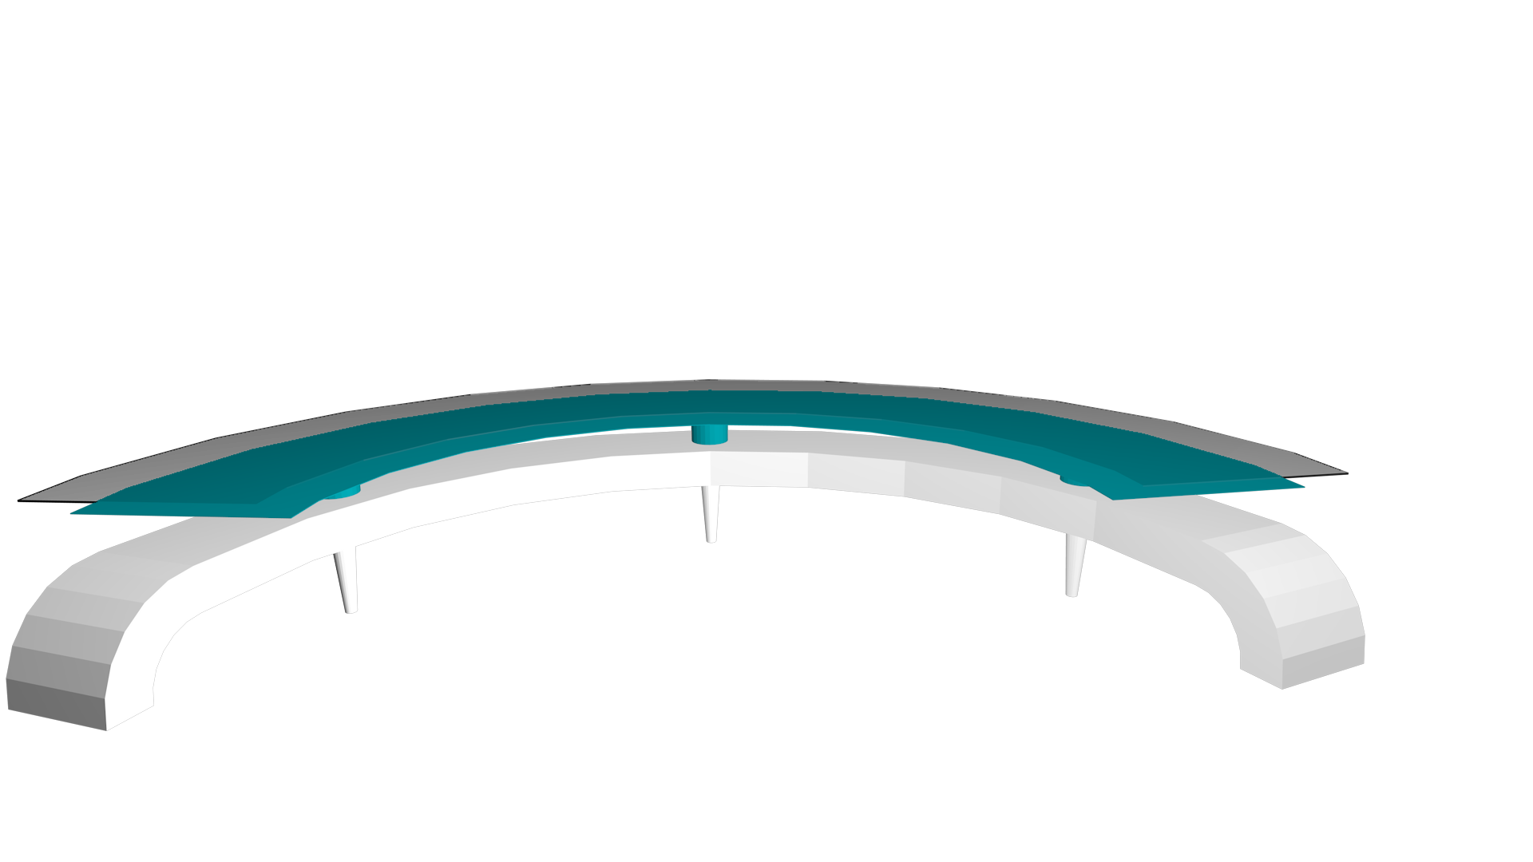
Welcome!
Spirit Creek Library Media Center
Ms. New, Library Media Specialist
newal@boe.richmond.k12.ga.us
706-592-3987 (Ext. 5)
Virtual Resources

